Slide 1
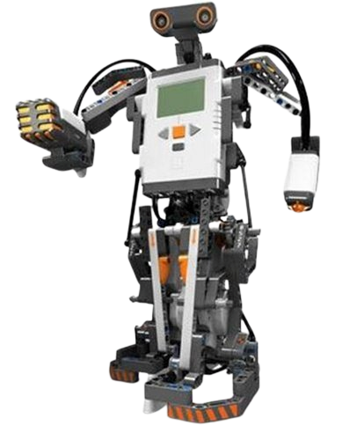

Towers of Hanoi Robot Arm
Christian Alcalde & Eric Fong

Slide 2
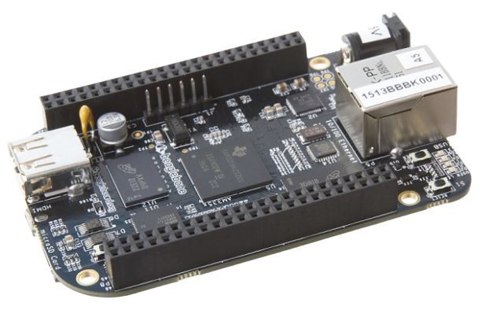
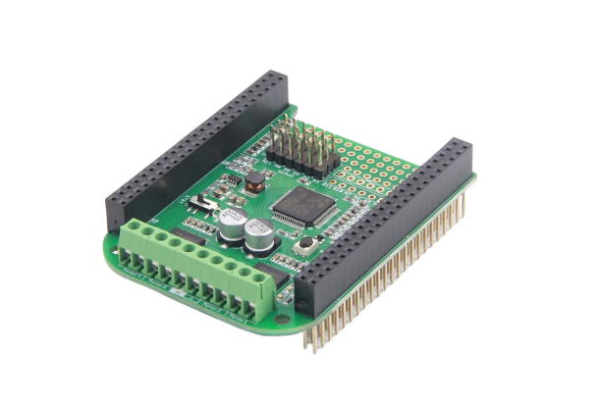
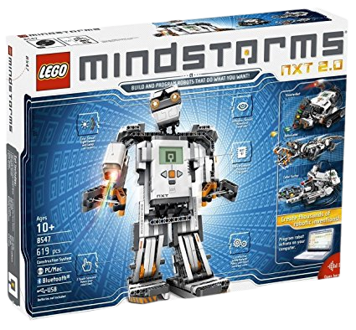
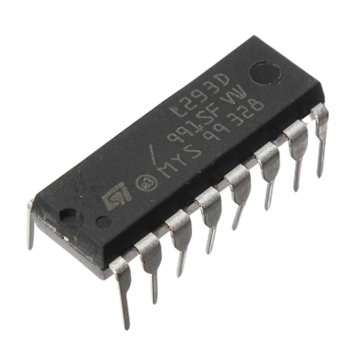
Materials:
BeagleBone Black
SeeedStudio Motor Bridge Cape
L293D H-Bridge
Push Button Switch
Lego Mindstorms NXT Kit
Breadboards
Resistors
Wires and solder

Slide 3
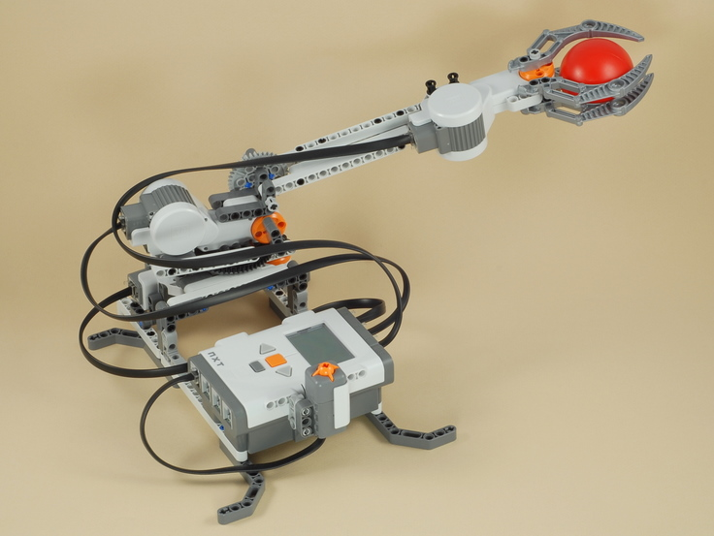
Goal
Create a robot arm that solves the Tower of Hanoi puzzle in the least amount of moves (7) using three rings. The robot arm will be constructed with Lego NXT parts controlled by our BeagleBone Black.

Slide 4
Towers of Hanoi
Objective: Move all disks from the leftmost pole to the rightmost
Rules:
Only one disk can move at a time
A larger disk cannot be placed on top of a smaller disk
All disks, except for the one being moved, must be on a peg at all times.

Slide 5
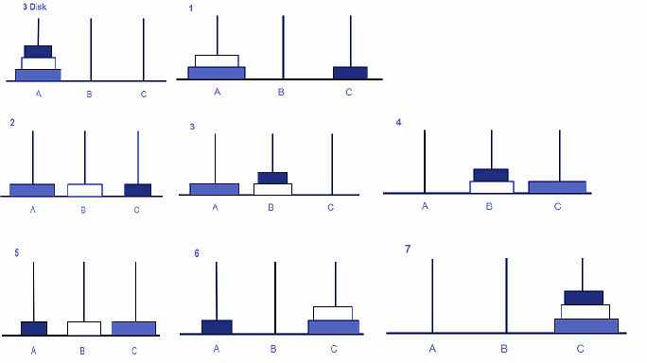
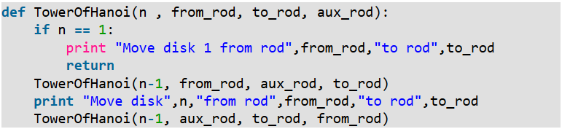
Algorithm
Output
Move disk 1 from rod A to rod C
Move disk 2 from rod A to rod B
Move disk 1 from rod C to rod B
Move disk 3 from rod A to rod C
Move disk 1 from rod B to rod A
Move disk 2 from rod B to rod C
Move disk 1 from rod A to rod C

Slide 6
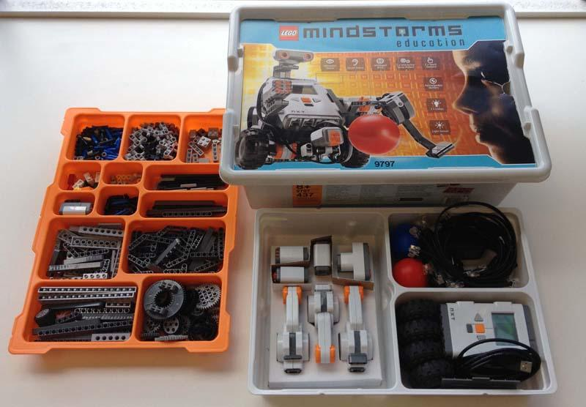
Lego Mindstorms NXT
A programmable robotics kit released by Lego
Gives people the power to build, program, and command your own Lego Robots
Instead of using the provided NXT brick, we used the BeagleBone Black to program and control the motors

Slide 7
What We Did
Purchased NXT ports
Soldered ports to custom wiring connections
Solder the custom modular connector on prototype breadboard and wires
Connect the ports to the NXT motors
Wire up necessary resistors and H-bridges on breadboard and BeagleBoard
Code the BeagleBoard with Python and associated libraries
Run the program by pressing the button switch

Slide 8
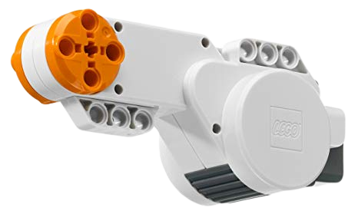
The NXT Motors
What kind of motors are they? - They turned out to be brushed DC motors
What are all of the pins used for? - Pins 1 and 2 are the positive and negative terminals for driving the motor (switching them reverses direction), pins 3 and 4 are the positive and negative power terminals for the rotation tracking, pins 5 and 6 are the rotary encoder outputs
What voltage should we supply to them? - The Beaglebone can only directly supply 5.5 V and 4 mA max, which don’t move motors very quickly or strongly

Slide 9
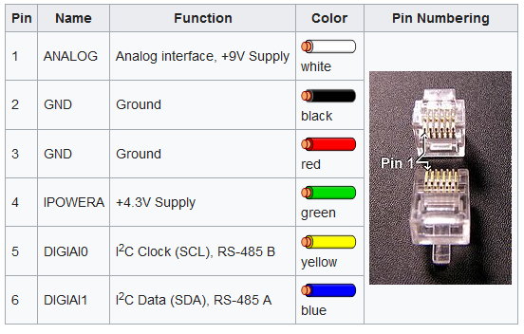

Slide 10
Controlling the NXT Motors
Externally supply 7 V to the motors
Need to switch driving voltage terminals for direction control
BBB computing transistors can’t handle the required voltage or current, this is a job for relays/purpose-built Integrated Circuit chips
Our IC of choice: the L293D - an H-bridge circuit capable of polarity switching
Three states needed for running the motors: forwards, backwards, halt
These are achieved by using +- polarity, -+ polarity, and opened circuit

Slide 11
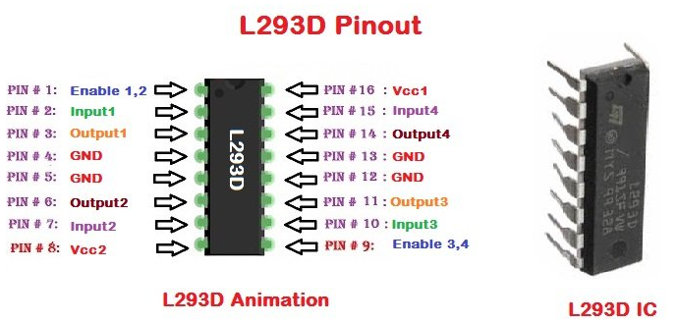

Slide 12
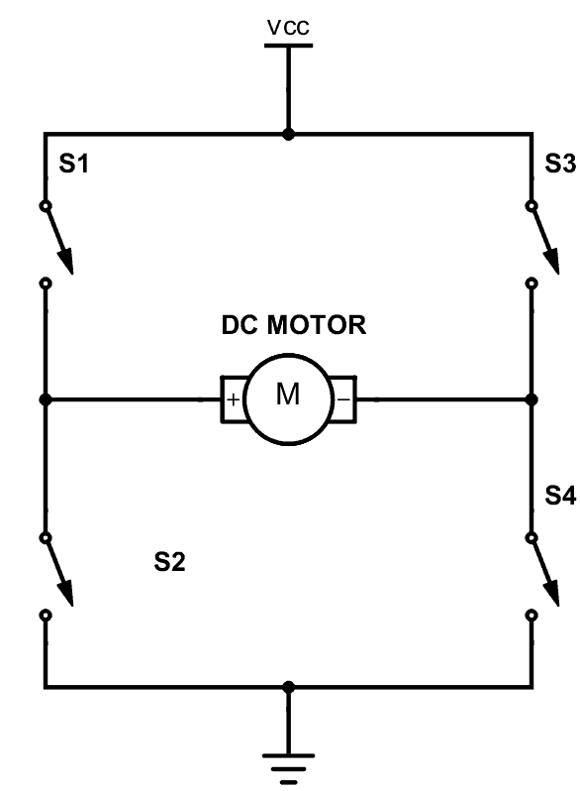

Slide 13
Discoveries While Building the Robot
Motor Bridge Cape
Required a lot of software fixing on arrival
Little to no updated support/resources online
Firmware it was shipped with was non-functional, required updating
Controller software used outdated version of Adafruit, that was no longer available
Ended up trying a different approach
L293D H-Bridge
Used two L293D H-Bridges with wires and resistors to control robot arm
H-Bridge allows for motors to reverse direction
Allowed us to write our own controller software in Python

Slide 14
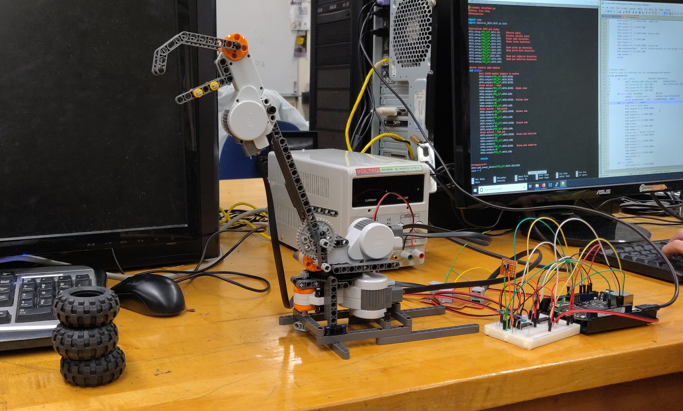
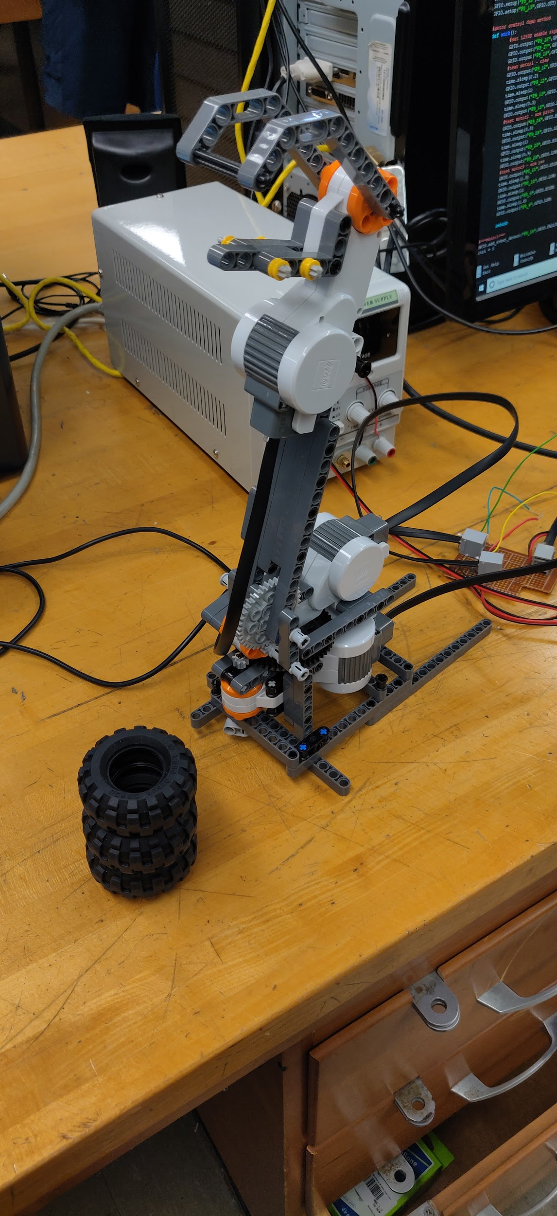
Our Robot Arm

Slide 15
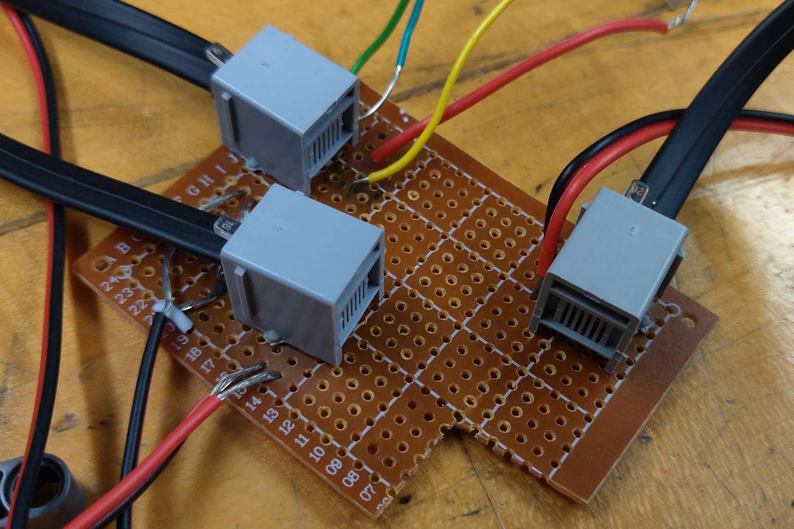
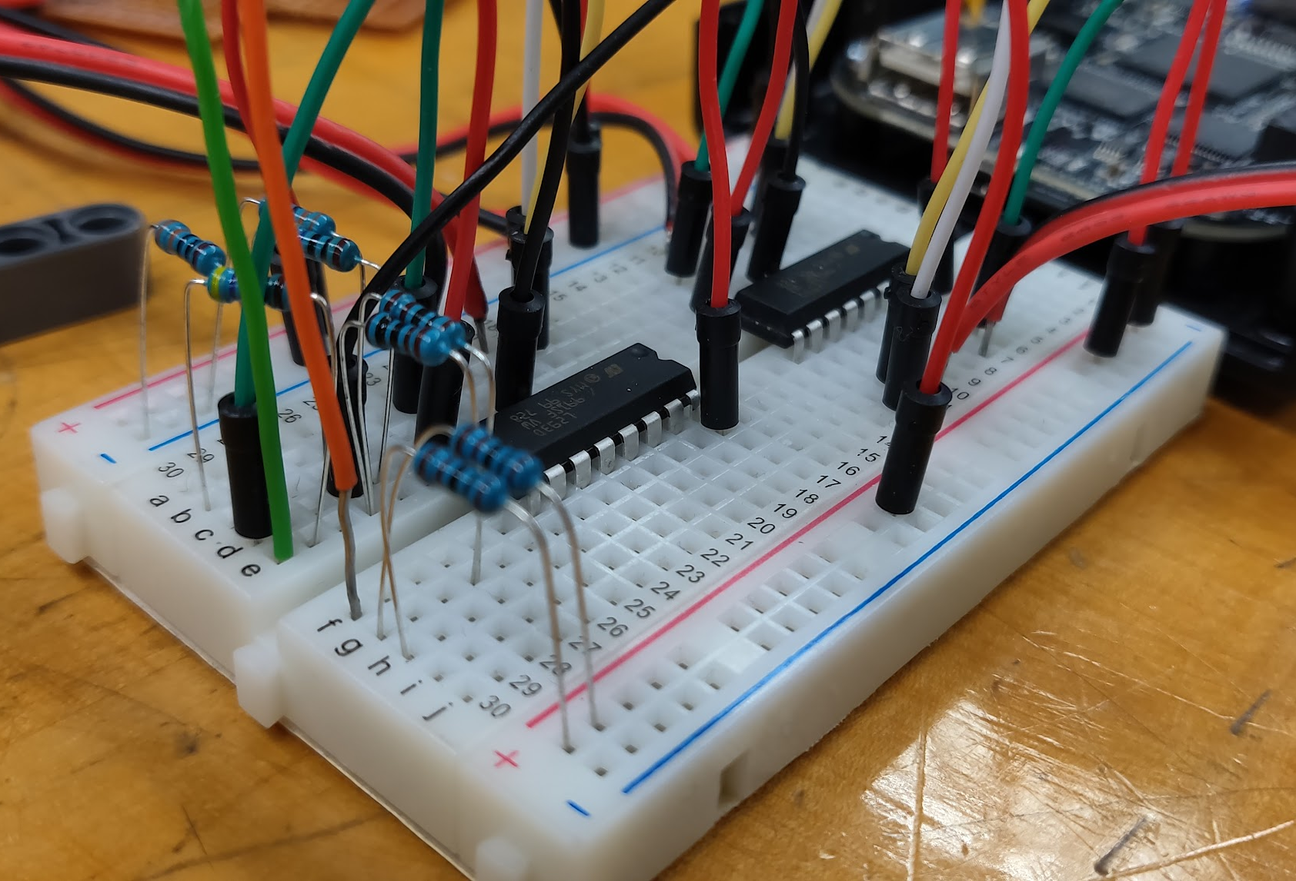
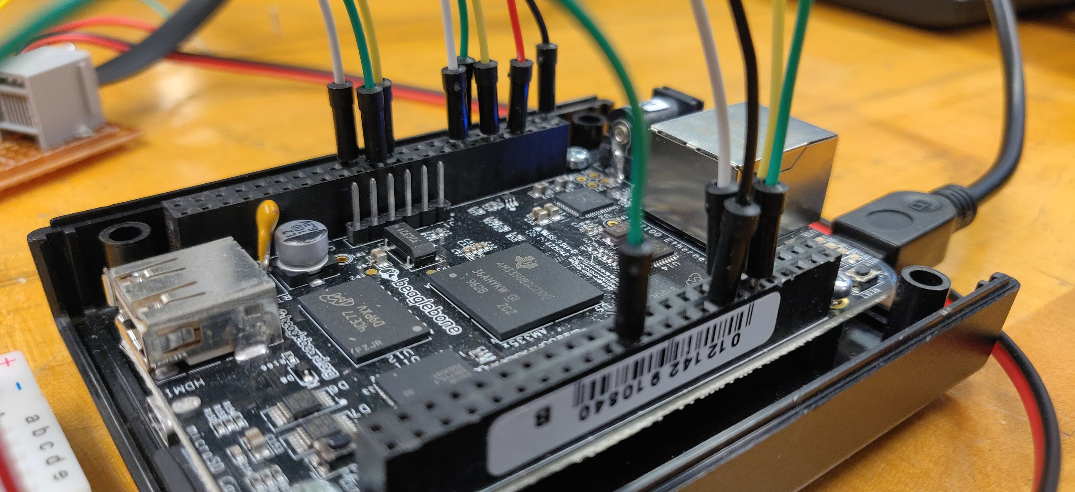
Wiring

Slide 16
